Slide 1
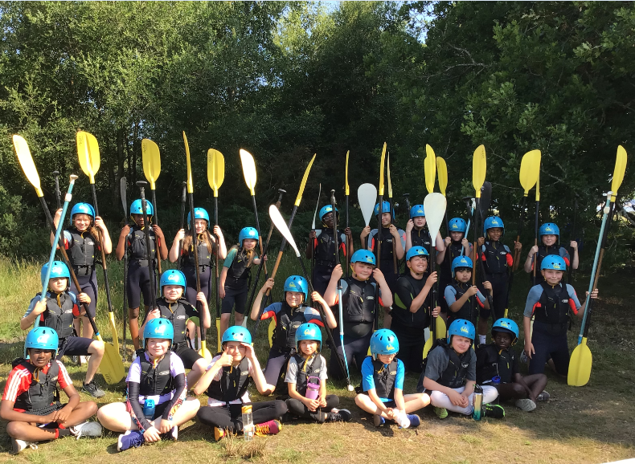
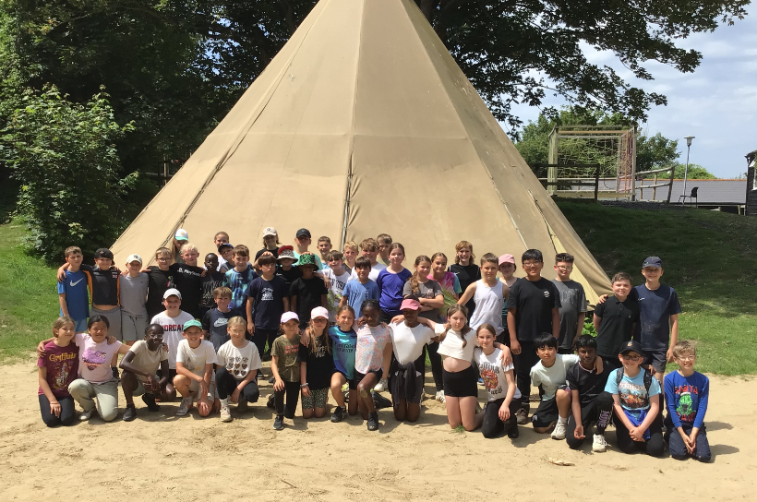
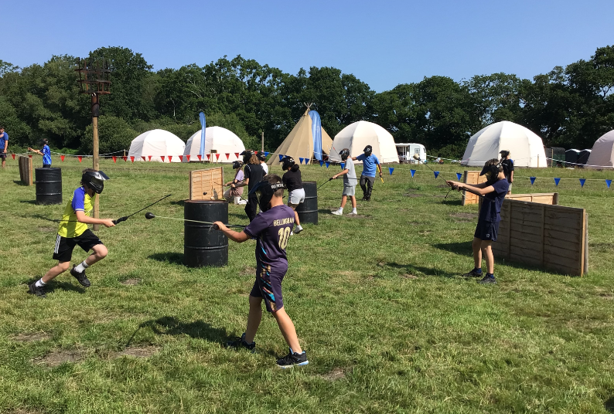
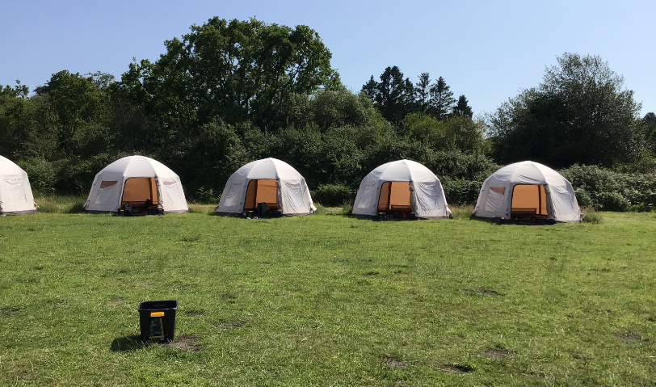
Year 6 Residential Meeting

Slide 2
Content of today’s meeting:
Dates, venue, travel
Accommodation and Facilities
Activities
Staffing and Supervision
Kit list, communication and questions

Slide 3
Joining with Amesbury Archer
To ensure the children are able to have a residential, we will be joining Amesbury Archer at the campsite and for activities. The schools will be accommodated separately on the same site and undertaken some activities together.
Mr Webber will be attending and overseeing both schools. Members of MVW staff will also be the point of contact for the children from MVW.
This is a great opportunity for the children to experience a residential in a safe environment and to interact with children from within MLP.

Slide 4
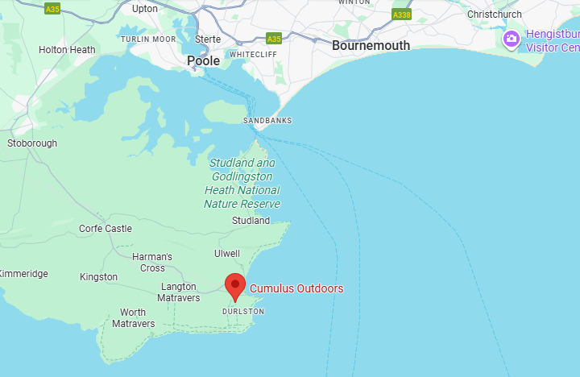
Dates, Venue and Travel
Cumulus Outdoors
Monday 14th June -
Wednesday 16th June 2027
We will be travelling by coach or minibus – it will take approximately 1.5 hours
Please let us know in advance if your child suffers from travel sickness so we can put the necessary provision in place.
Notes:
Drive to Moors Valley for play and to meet with other school. Then onto Cumulus.

Slide 5
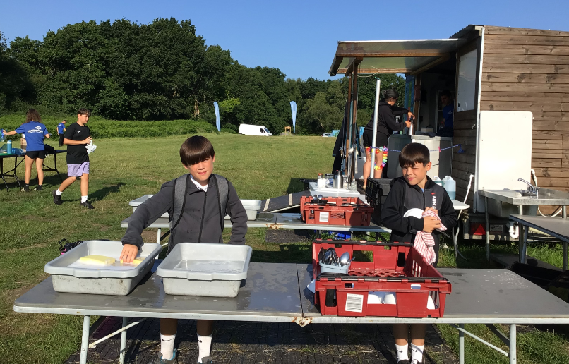

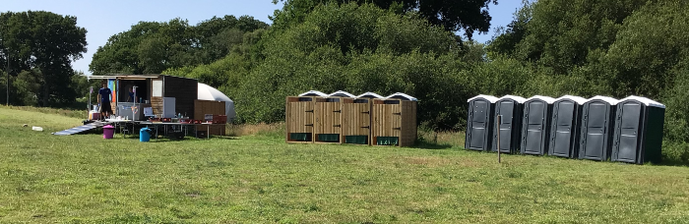
Accommodation and Facilities
Notes:
Children are camping and sleep in tents overnight. All the facilities they need are provided including the tents, food, toilets and showers. Children are very busy, and with adult supervision run the camp themselves.

Slide 6
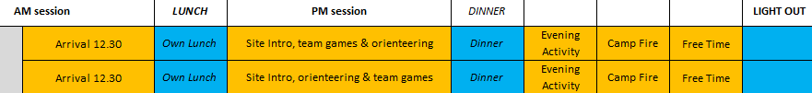
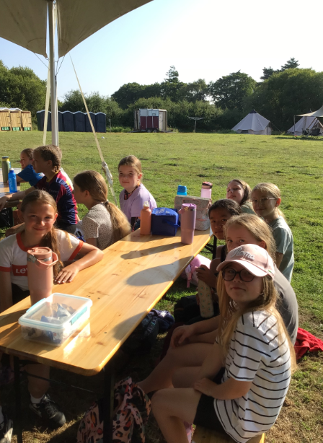
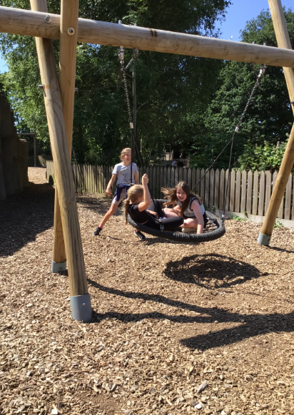
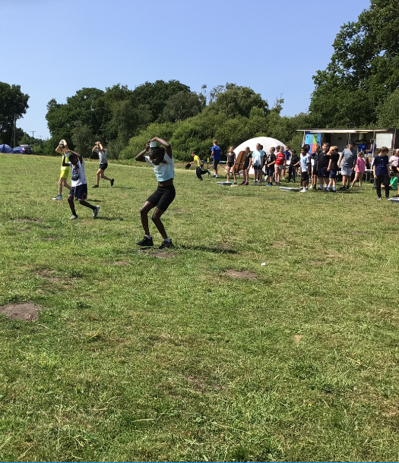
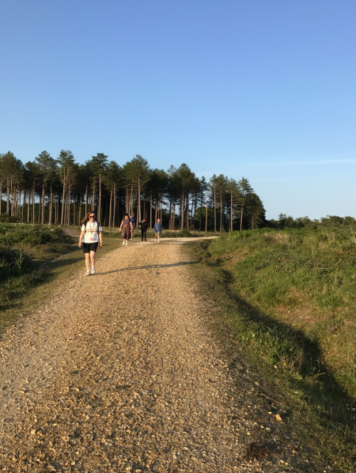
Activities - Day 1

Slide 7

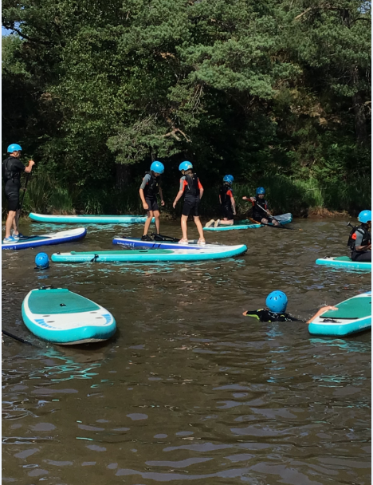
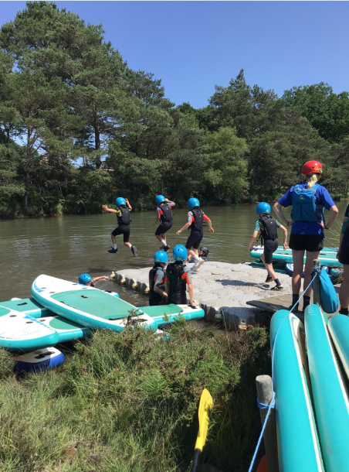
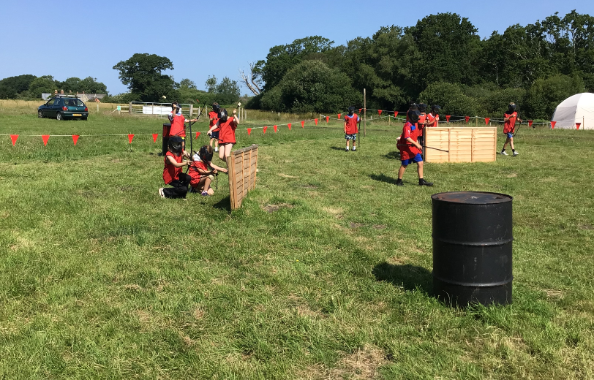
Activities - Day 2

Slide 8
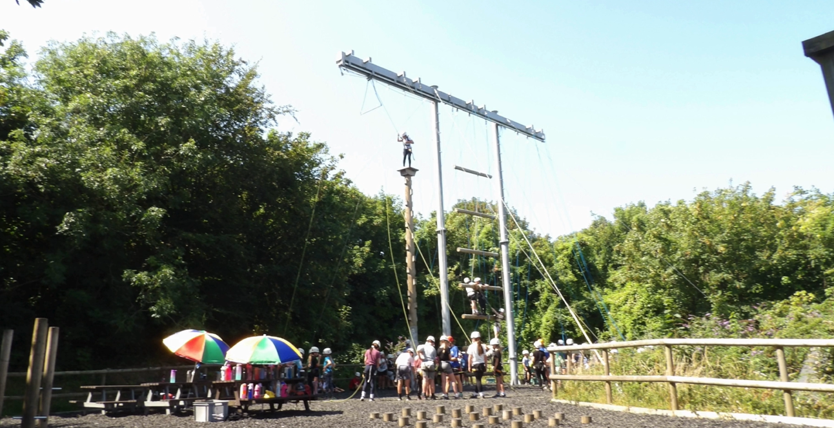
Activities - Day 3
On the third day, the children will take part in a high ropes course at the Cumulus centre. After lunch, the children will depart to arrive back at school for normal time pickup.

Slide 9
Staffing and Supervision
Cumulus staff (fully trained and DBS checked) run the site and activities for the children.
School staff there to provide additional support and supervision.
Full list of school staff attending TBC. Mr Webber will be going with some other staff members.
Children are never left alone in any situation – toilet trips are made in pairs at night. Staff stay on site and attend activities with the children.

Slide 10
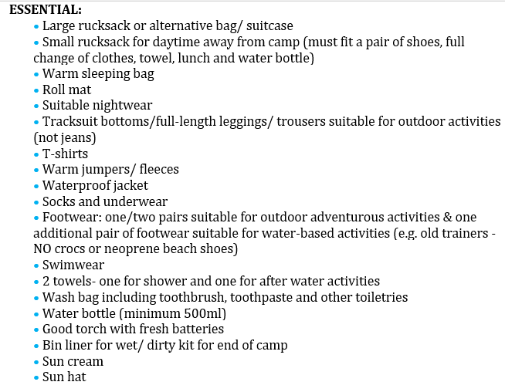
Kit List, Communication and Questions
Notes:
Mobile phones not allowed, the children are busy and we want them to enjoy the activities they are meant to be there for. Also do not want to risk them getting lost or damaged.
Communication with home is restricted as phones are not allowed. We will make sure that lots of photos are uploaded daily onto the school’s Facebook account and an album made on our return. If you feel that not taking a phone not being in contact would create discomfort or extreme distress during the trip please get in touch and we will see what provision we could put into place for them to be able to go.

